Slide 1
CoFM: An Environment for Collaborative Feature Modeling
Li Yi
Peking University
2010.10.28

Slide 2
Agenda
Motivation
The CoFM
Concepts
Process
Tool Support
Case Study
Summary & Future Work

Slide 3
Agenda
Motivation
The CoFM
Concepts
Process
Tool Support
Case Study
Summary & Future Work

Slide 4
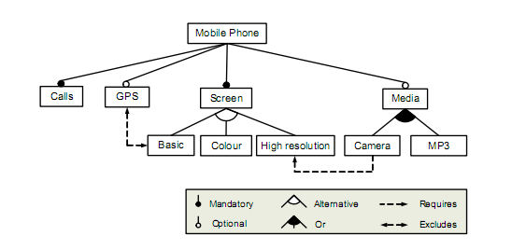
Background: Feature Models
Feature
Refinement
Constraint
from Feature Oriented Domain Analysis (FODA) Feasibility Study,
CMU/SEI-90-TR-21, 1990

Slide 5
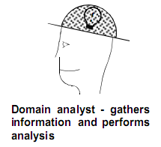
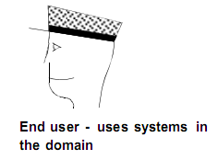
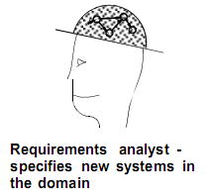
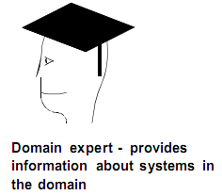
First, a feature model needs to be constructed…
…with collaboration between stakeholders
(from FODA & FORM)
FM

Slide 6
However, few of existing methods and tools have supported such collaboration explicitly, leading to problems…
The collaboration is often constrained by the limit of time and distribution of location among the stakeholders
Thus the efficiency of the collaboration is often unsatisfied
The collaboration is usually domain-analyst-centric
It takes a lot of effort for domain analysts to obtain necessary knowledge from other stakeholders, which makes FM construction a time-consuming and error-prone task
FMs are hard to maintain and evolve with the (often fast changing) domain

Slide 7
Our Approach: the CoFM Environment
Provide an environment to allow multiple users to construct FMs collaboratively
Basic Idea
User 3
A
Supported by: 3 / 3
A
A
B
User 1
B
User 2
Supported by: 1 / 3
C
A
Supported by: 1 / 3
C

Slide 8
Agenda
Motivation
The CoFM
Concepts
Process
Tool Support
Case Study
Summary & Future Work

Slide 9
The Meta-model of Feature Models in CoFM
Create
Vote
Constraint
Operation
*
Relationship
Element
Stakeholder
*
*
Refinement
+supporters
+opponents
1
Feature
1
*
*
+parent
*
*
1
+child
1
1
Global
FM
Name
1..*
1
1
Working
Description
*
*
1
View
1
Personal
Optionality
Has attribute

Slide 10
Operations for Users
Creating operations
Add a new element to the shared FM
Voting operations
Express opinions to an existing element: support/oppose the element’s existence in the FM
Voting options: YES or NO

Slide 11
Automatic Voting Inference
The problem of inconsistent voting operation from a user
Example:
The user voted NO on it
The user voted YES on it
F-A
F-A
requires
requires
Inconsistency
F-B
F-B
F-A should require F-B;
F-B should NOT exist;
Existence of a relationship needs the existence of its involved features

Slide 12
Voting Inference Rules (VIRs)
VIR-1a: Vote NO on feature F → Vote NO on each relationship R which involves F
VIR-1b: Vote YES on relationship R → Vote YES on each feature which is involved in R
F-A
F-A
The user voted NO on it
An inferred NO vote
F-A
F-B
F-B
F-B
F-A
F-A
The user voted YES on it
An inferred YES vote
F-B
F-B

Slide 13
VIRs(Feature/Attribute)
VIR-2a: Vote YES on an attribute of feature F → Vote YES on F
VIR-2b: Vote NO on feature F → Vote NO on all attributes of F
Existence of an attribute of a feature requires the existence of the feature

Slide 14
VIR (from Creating)
VIR-3: Create an element E → Vote YES on E
Although we haven’t provided the deleting operation directly, we allow users to delete via voting
All votes on element E are NO → Delete E
NOTE: We don’t distinguish explicit votes from inferred votes.

Slide 15
Views of the Shared Feature Model
Global View
GV = {all elements which has at least one YES vote}
Working View for User X
WV(X) = {all elements on which X hasn’t voted NO}
Personal View for User X
PV(X) = {all elements on which X has voted YES}
Anything available
Anything that I don’t dislike, or I haven’t noticed
Anything I want

Slide 16
Role of the Views
User 3
A
A
B
Personal views show each user’s understanding of the domain
In between, working views hide unwanted elements of the users;
it is designed as the main workspace of the users.
User 1
User 2
A
Supported by: 3 / 3
C
A
B
Supported by: 1 / 3
C
Supported by: 1 / 3
Global views show the whole picture of the shared FM

Slide 17
Agenda
Motivation
The CoFM
Concepts
Process
Tool Support
Case Study
Summary & Future Work

Slide 18
The Process
Stakeholder 1
Discuss with others
LEGEND
Submit operations
Switch between views
Stakeholder Activity
Supporting Activity
Infer votes
Coordinate and apply changes
Artifact
Update views
Shared Feature Model
Update views
. . .
Update views
Stakeholder 2
Stakeholder 3

Slide 19
An Example of the Process
How to construct this…
3 / 3
User 3
A
A
B
C
A
B
1 / 3
1 / 3
User 1
User 2
A
C

Slide 20
A
The Shared Feature Model
Send to…
A
User 3
User 1
A
Broadcast…
User 2
A
U1 Create A

Slide 21
A
The Shared Feature Model
C
A
User 3
User 1
A
C
C
User 2
A
U1 Create A
U2 Create C
C

Slide 22
A
The Shared Feature Model
A
User 3
B
C
A
User 1
B
C
X
X
B
C
User 2
A
Vote NO
U1 Create A
U2 Create C
U1 Create B
U3 Vote NO on B & C
B
C

Slide 23
A
The Shared Feature Model
A
B
C
User 3
User 1
B
C
Vote NO
A
U1 Create A
U2 Create C
U1 Create B
U3 Vote NO on B & C
U1 Vote NO on C
U2 Vote NO on B
User 2
A
Vote NO
B
C

Slide 24
A: supported by 3 / 3
B: supported by 1 / 3
C: supported by 1 / 3
A
The Shared Feature Model
A
B
User 3
User 1
B
C
A
U1 Create A
U2 Create C
U1 Create B
U3 Vote NO on B & C
U1 Vote NO on C
U2 Vote NO on B
User 2
A
C

Slide 25
Issue in the Process
Concurrency Control:
How to coordinate simultaneous operations from different stakeholders on the same element?
There are possibly 3 types of concurrency control issues, according to the operations
Create / Create
Vote / Vote
Create / Vote

Slide 26
Concurrency Control
The Create-Create conflict
create E
update FM
create E
success
S1
S1
S2
time
S2
time
create E
create E
vote YES on E
Duplicate Creation
create name N for feature F1
create name N for feature F1
update FM
success
S1
S1
S2
time
S2
time
create name N for feature F2
create name N for feature F2
fail and undo
Conflicting Aliases

Slide 27
Concurrency Control
The Vote-Vote conflict
vote NO on E will lead to deletion
(create)
update FM
S1
E
S2
time
vote YES on E
?
Unreachable Vote
vote NO on E
(create)
success
S1
E
time
S2
vote YES on E
fail and undo

Slide 28
Concurrency Control
The Create-Vote conflict
vote NO on F1 leads to deletion
(create)
update FM
S1
F1
S2
time
create constraint F1 → F2
?
Incomplete Creation
The creation is incomplete because corresponding vote inference cannot be finished.
vote NO on F1
(create)
success
S1
F1
time
S2
create constraint F1 → F2
fail and undo

Slide 29
Agenda
Motivation
The CoFM
Concepts
Process
Tool Support
Case Study
Summary & Future Work

Slide 30
Tool Support for CoFM
C/S architecture
Support for concepts and process introduced before
Support for communication via comments and discussion pages
Uses
Domain analysis (including 2 case studies)
Feature request for tools being developed in our research group, including CoFM itself

Slide 31
The editing location of others
Controversial features

Slide 32
Agenda
Motivation
The CoFM
Concepts
Process
Tool Support
Case Study
Future Work

Slide 33
The Cases
Case | Intro | # of Features | # of Participants | Time
Music Player | Domain feature model for music playing software such as iTunes. It is a familiar domain to the participants. | 158 | 3 | About 1.5 hours
Job Finding Website | Domain feature model for job finding websites. It is an unfamiliar domain to the participants. | 113 | 4 | About 3 hours
Notes:
The cases are conducted in Chinese, I translate them into English here, for your convenience.

Slide 34
Results of the Job Finding Website Case

Slide 35
Result (cont.): Distribution of Contributions among Participants

Slide 36
Result (cont.): Distribution of Features’ Support Rates

Slide 37
Main Observations
Ob 1: The collaborative work can be roughly divided into 2 phases
Brainstorming phase: a large number of features are created over a short period of time
Evaluation phase: adjust features and relationships; lots of voting operations and comments

Slide 38
Evidence from the Job Finding Website Case
128
122
121
120
117
113
111
82
43
Brainstorming Phase
Evaluation Phase

Slide 39
Main Observations (cont.)
Ob 2: The efficiency of domain feature modeling is improved, in 3 dimensions:
Parallel construction happens in different part of a feature model
Low interferer between different user’s work
Users often get inspired by others’ work
Notes:
Consider the “Low interferer” in details.

Slide 40
Agenda
Motivation
The CoFM
Concepts
Process
Tool Support
Case Study
Summary & Future Work

Slide 41
Summary
CoFM provides a simple but effective way to support collaborative feature modeling
Creating and Voting as the basic operations
Rules to ensure correctness of committed operations
Views to help people work
Case study gives positive results
Efficiency of feature modeling is improved

Slide 42
Future Work
Functions of the tool
Provide statistics about feature models for the users.
Enable users to export their personal (views of) feature models to local documents, or into other tools.
Calculate confidence/priority of users’ operation
Provide mechanisms to identify constraints between features for users (semi-auto.)
More cases (larger scale, more people, and more distributed)

Slide 43
Thanks for your listening! Comments and questions are appreciated!

